Slide 1
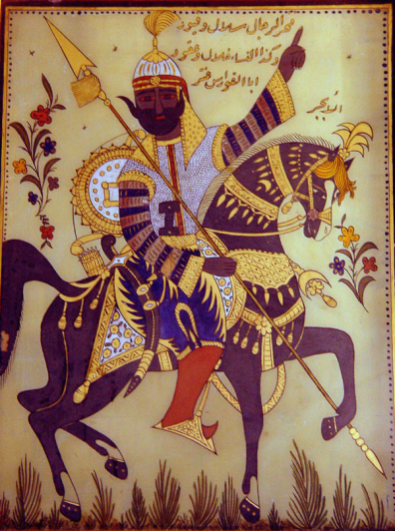
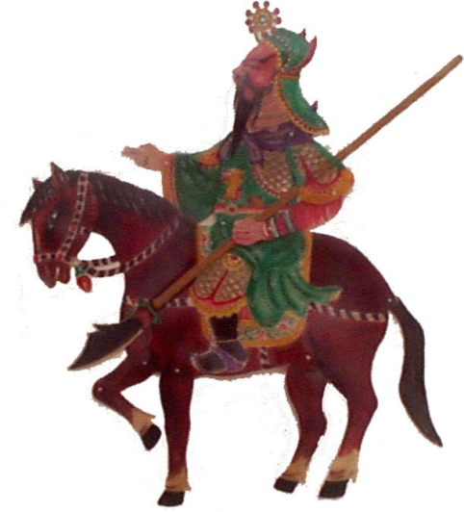
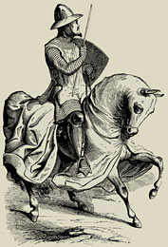
The Late Bronze Age
The Third Phase of Civilization
(c. 1550-1200 BCE)

Slide 2
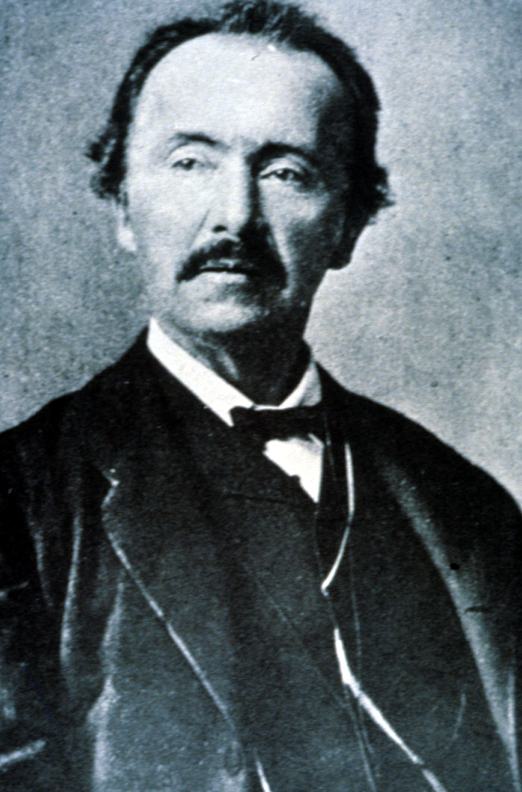
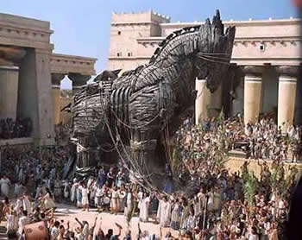
Mycenae (c. 1600-1100)
Legend
Key Terms
Trojan War

Slide 3
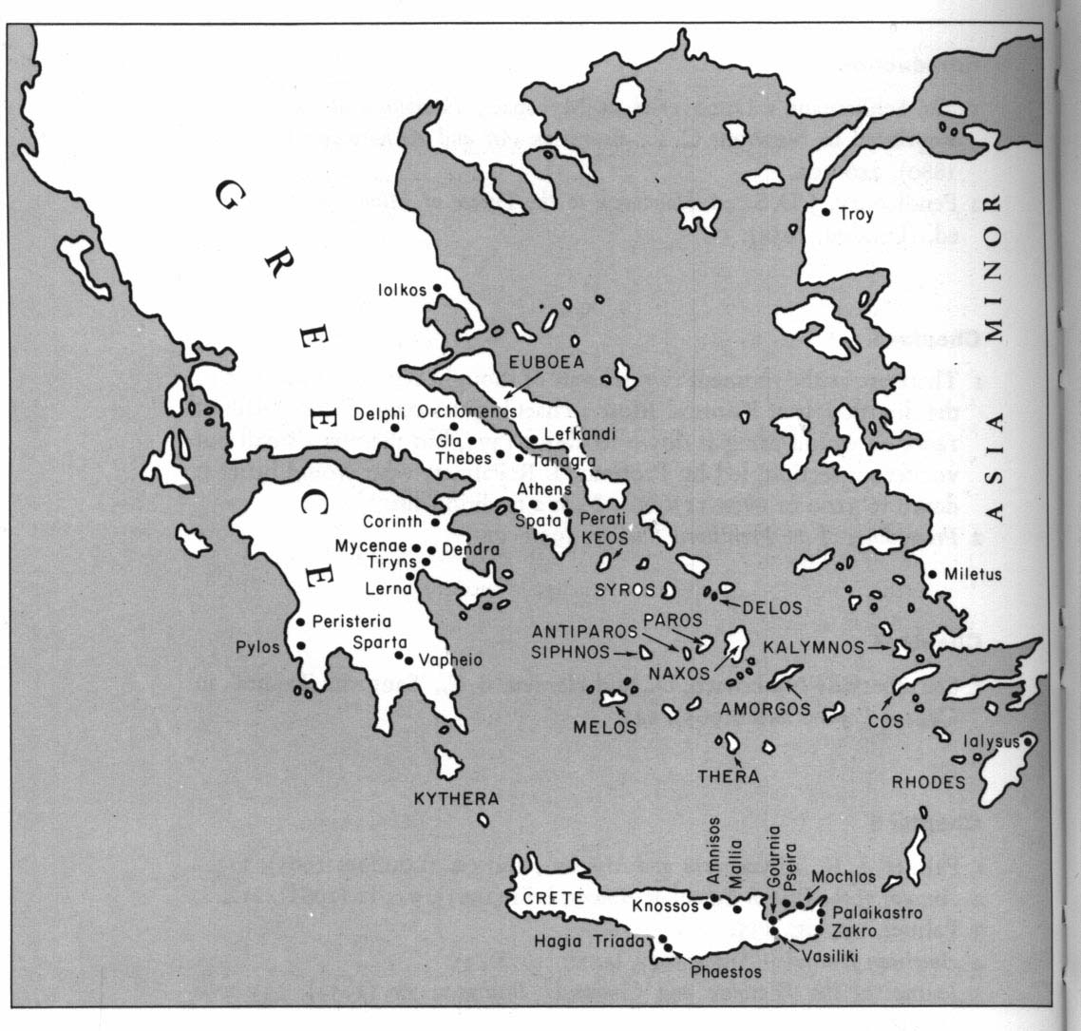

Slide 4
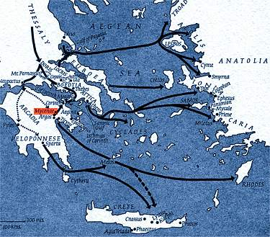
Mycenae (cont’d)
Rise of the Mycenaeans
Political Structure
Language
Religion
Fall
Key Terms
Mycenae/Mycenaeans
Linear B

Slide 5
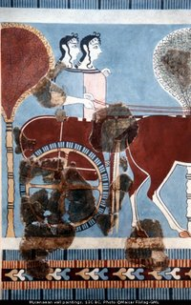
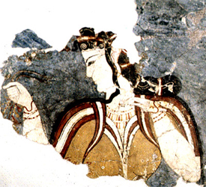
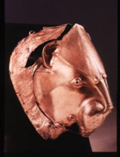
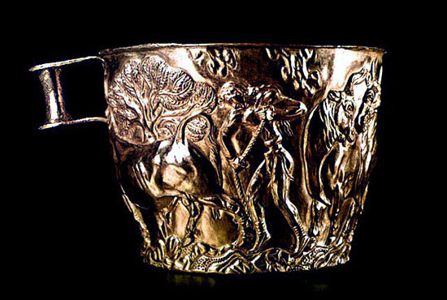

Slide 6
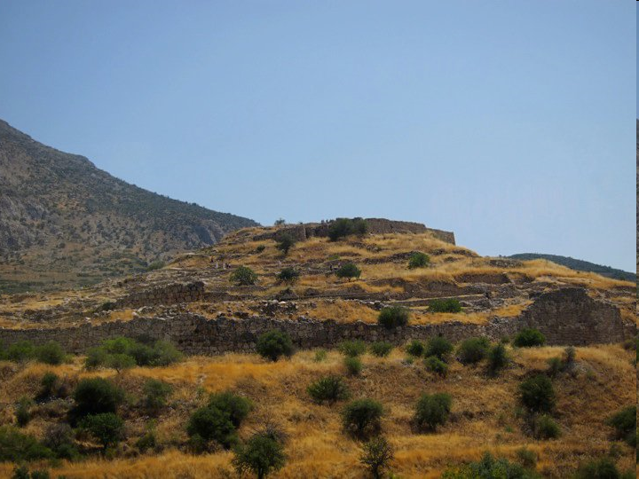

Slide 7
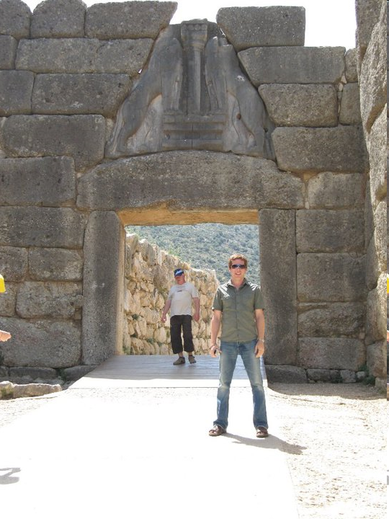
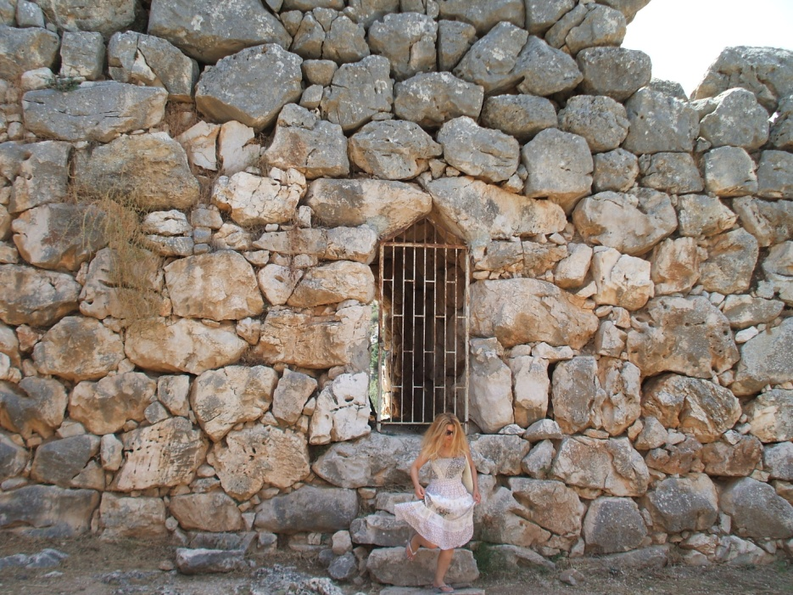
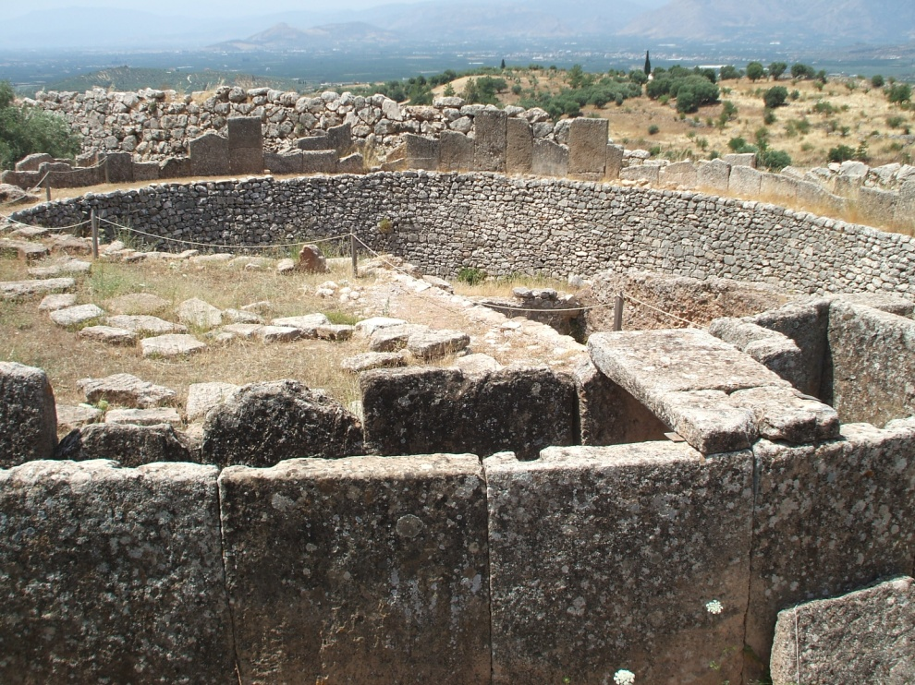

Slide 8
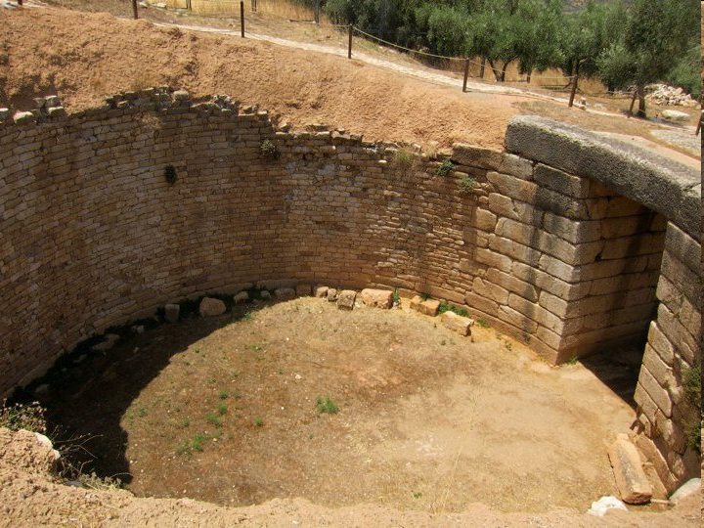
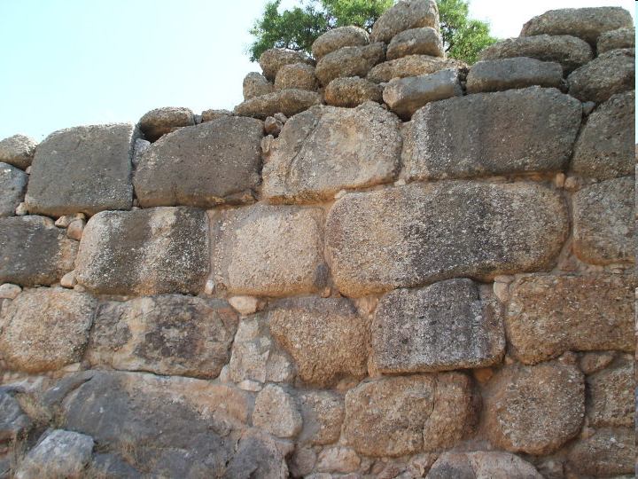
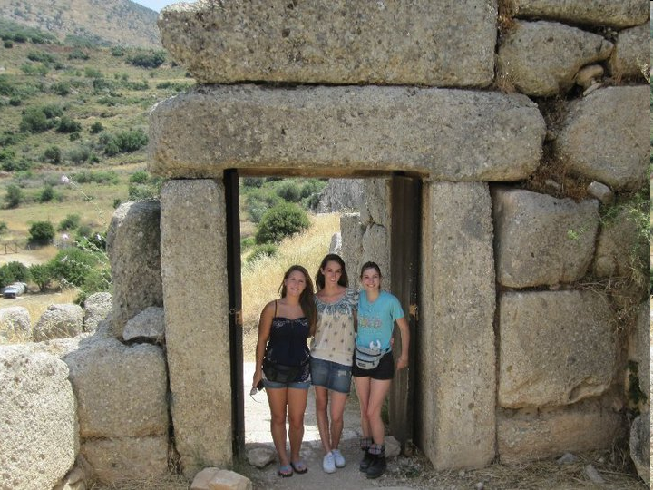
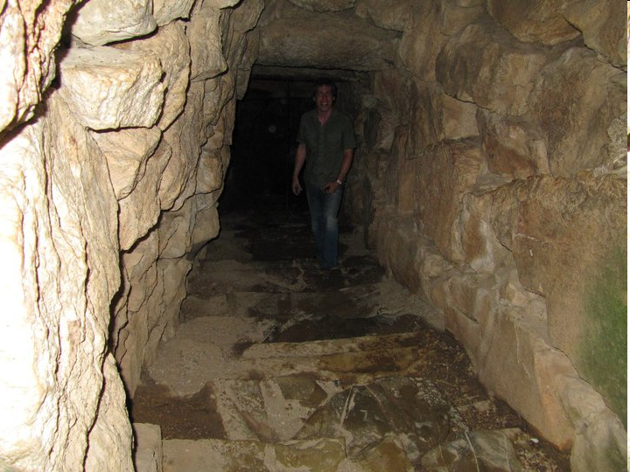

Slide 9
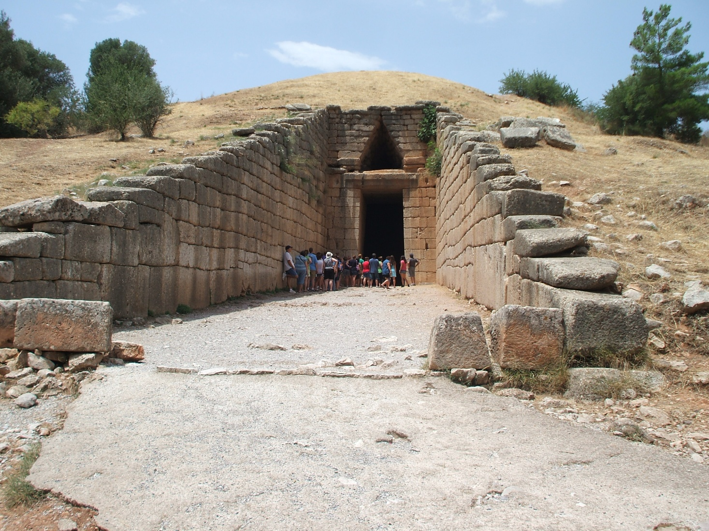
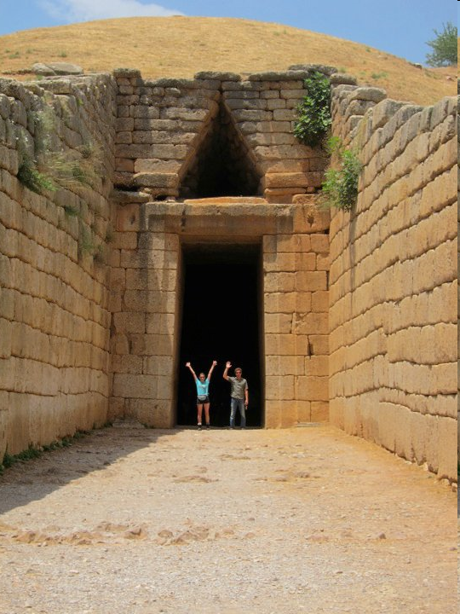
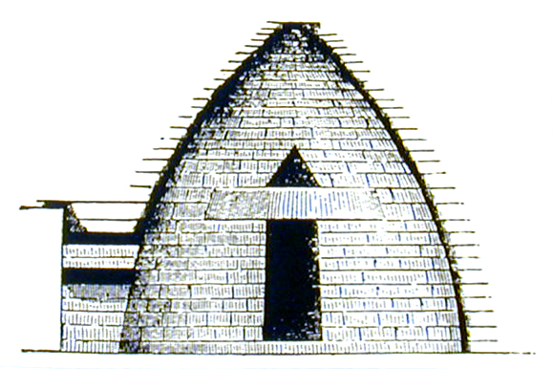

Slide 10
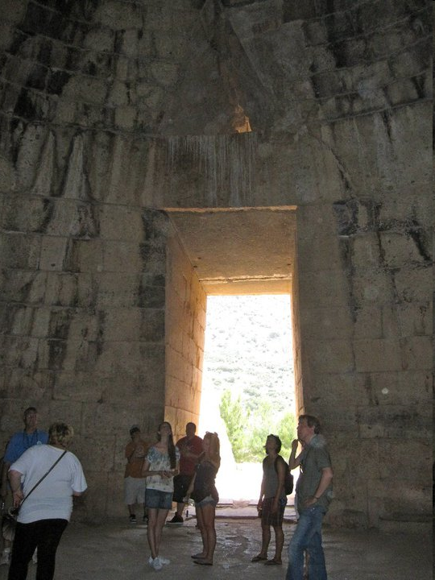
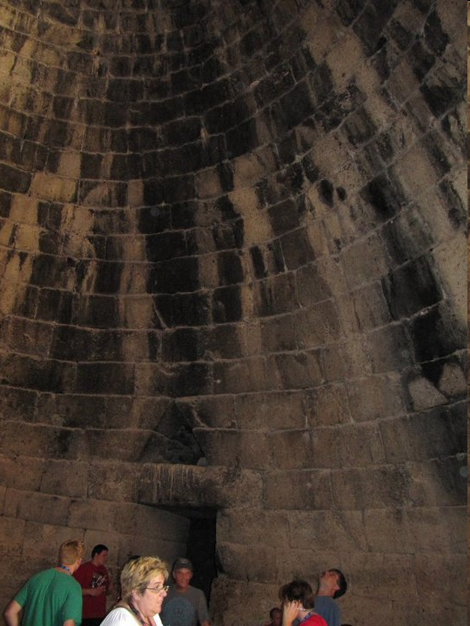

Slide 11
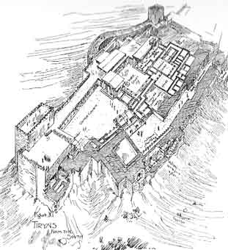
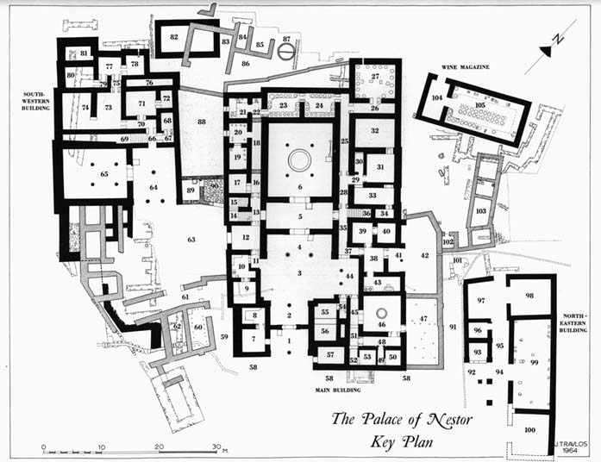
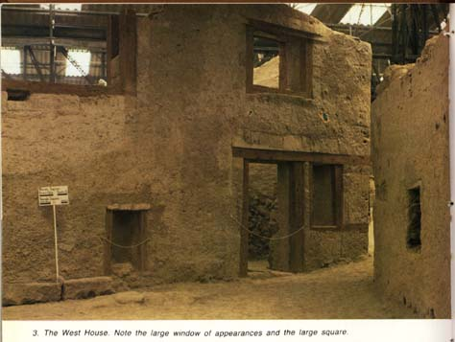

Slide 12
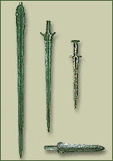
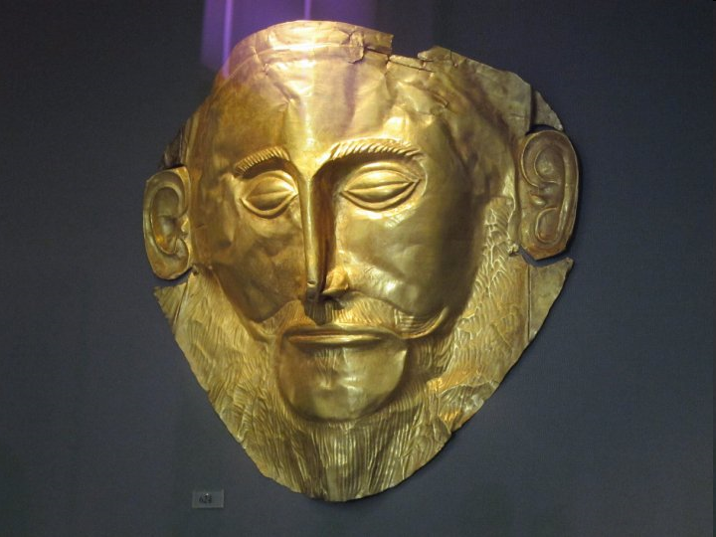
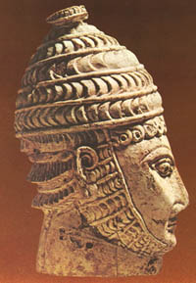
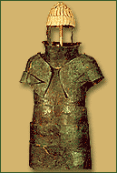
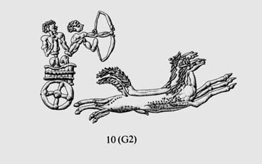
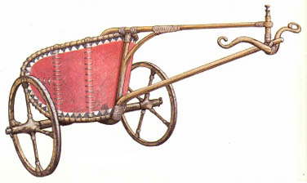

Slide 13
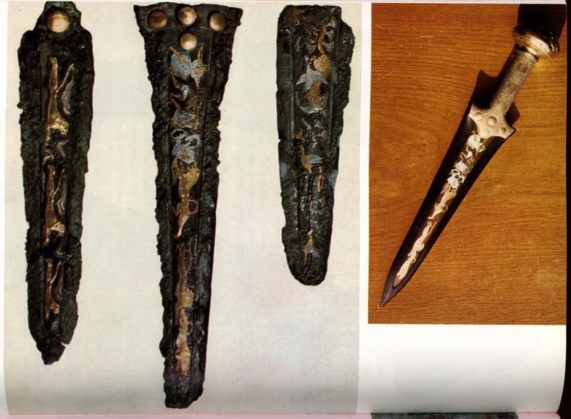

Slide 14
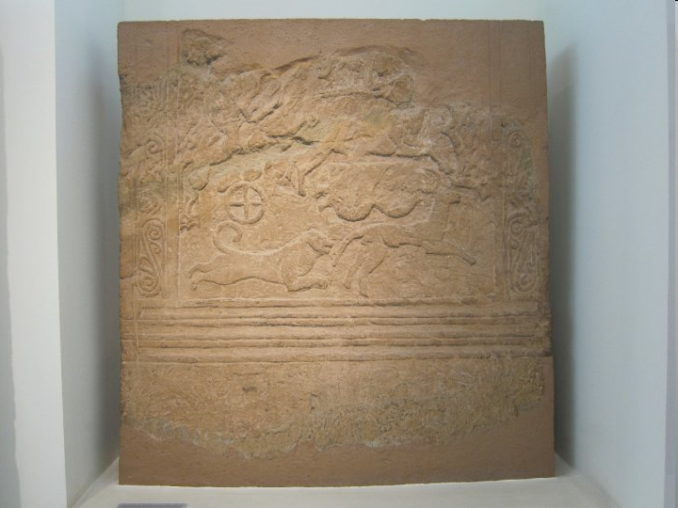
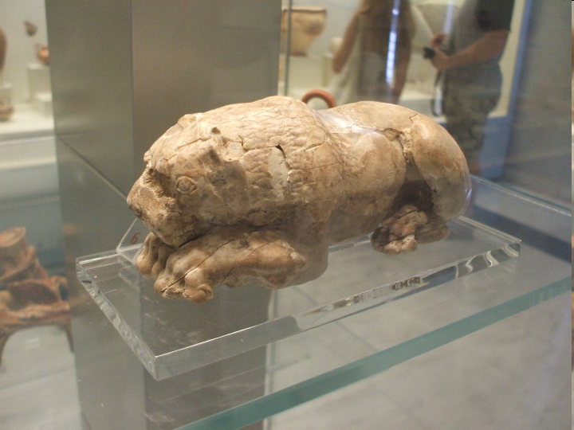

Slide 15
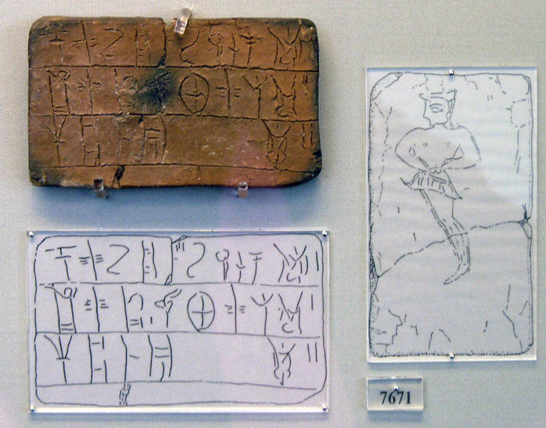

Slide 16
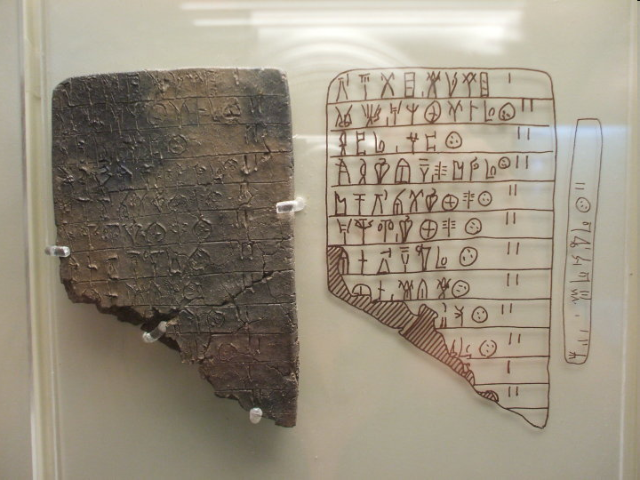

Slide 17
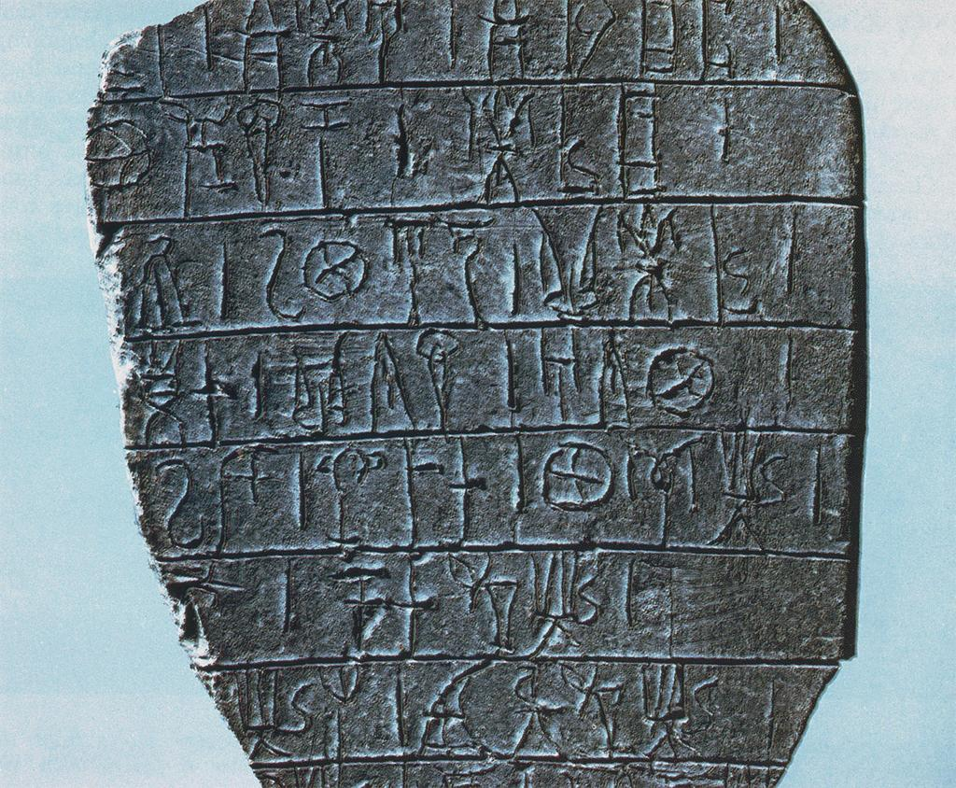

Slide 18
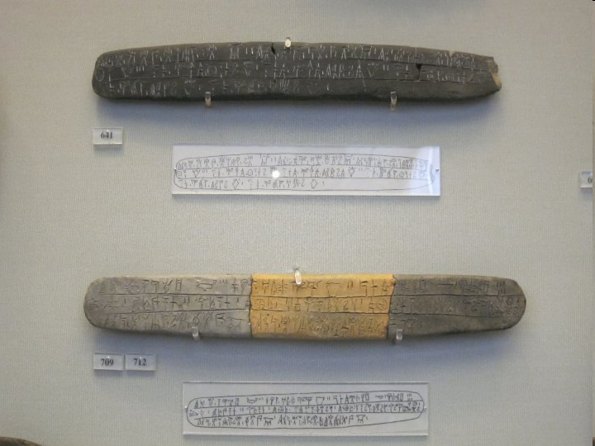

Slide 19
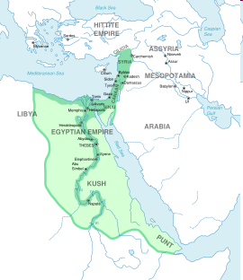
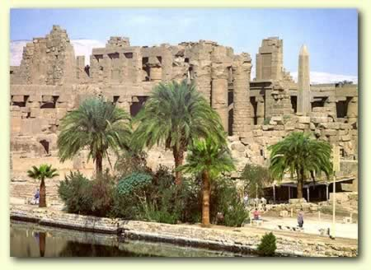
The Egyptian Empire (c. 1570-1070)
Key Terms
Amun
Karnak
The New Kingdom

Slide 20
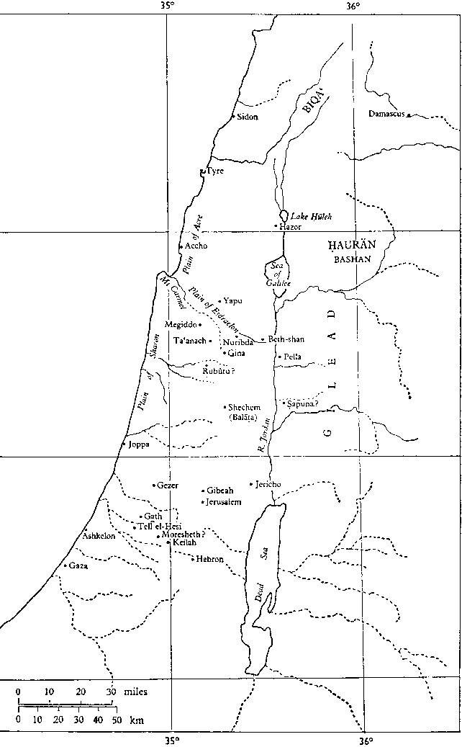
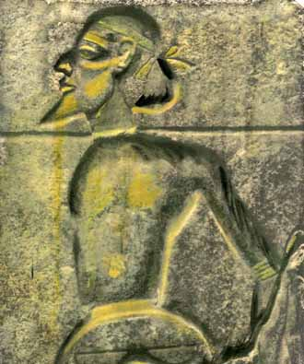
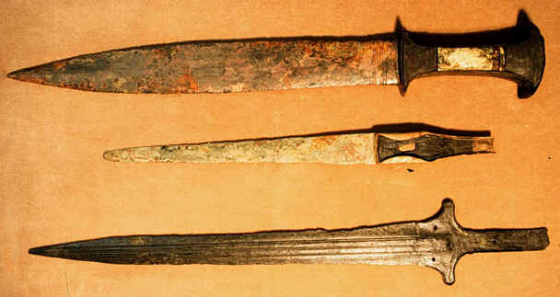
The Egyptian Empire (cont’d)
Egypt and the Canaanites
Thutmose III (1504-1450)
Battle of Megiddo (1481)
Key Terms
Thutmose III
The ‘Apiru
The Shasu

Slide 21
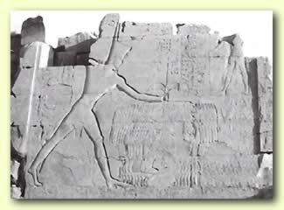
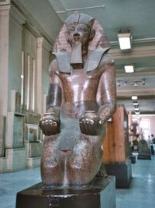
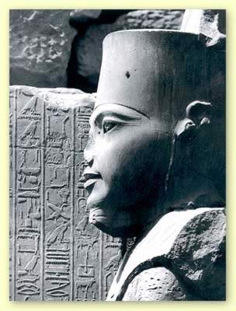

Slide 22
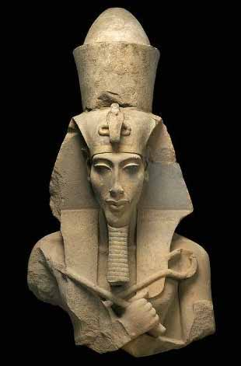
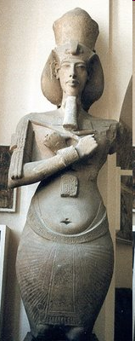
The Egyptian Empire (cont’d)
The First Documented Monotheist
Key Terms
Akhenaten
Aten

Slide 24
Mitanni (c. 1600-1335 BCE)
Rise
Political Structure
Defeat by Egypt (1472)
Demise
Key Terms
Mitanni
maryannu
Shaushtatar
Stela of Shaushtatar

Slide 26
Palace at Tel Brak in Syria
Tushratta’s Letter to Amenhotep III

Slide 27
Hatti (c. 1700-1190)
Old Kingdom (c.1700-1500)
New Kingdom (c.1400-1190)
Suppiluliuma (1344-1322)
Battle of Qadesh (1274)
Key Terms
Hatti / Hittites
Suppiluliuma
Ramesses II

Slide 32
Assyria
Middle Assyrian Period (c. 1350-1180)
War of Independence
Ashur-uballit I (1363-1328)
Culture
Key Terms
Ashur
Ashur-uballit I
ilku-service

Slide 34
Tombs of the Middle Assyrian kings at Ashur

Slide 35
Middle Assyrian Laws (excerpts)
I.2. If a woman, whether the wife of a man or the daughter of a man, utter vulgarity or indulge in low talk, that woman bears her own sin; against her husband, her sons, or her daughter they shall have no claim.
I.7. If a woman bring her hand against a man, they shall prosecute her; 30 manas of lead shall she pay, 20 blows shall they inflict on her.
I.8. If a woman in a quarrel injure the testicle of a man, one of her fingers they shall cut off. And if a physician bind it up and the other testicle which is beside it be infected thereby, or take harm; or in a quarrel she injure the other testicle, they shall destroy both of her eyes.
I.9. If a man bring his hand against the wife of a man, treating her like a little child, and they prove it against him, and convict him, one of his fingers they shall cut off. If he kiss her, his lower lip with the blade of an axe they shall draw down and they shall cut off.
I.12. If the wife of a man be walking on the highway, and a man seize her, say to her "I will surely have intercourse with you," if she be not willing and defend herself, and he seize her by force and rape her, whether they catch him upon the wife of a man, or whether at the word of the woman whom he has raped, the elders shall prosecute him, they shall put him to death. There is no punishment for the woman.
I.13. If the wife of a man go out from her house and visit a man where he lives, and he have intercourse with her, knowing that she is a man's wife, the man and also the woman they shall put to death.
I.14. If a man have intercourse with the wife of a man either in an inn or on the highway, knowing that she is a man's wife, according as the man, whose wife she is, orders to be done, they shall do to the adulterer. If not knowing that she is a man's wife he rapes her, the adulterer goes free. The man shall prosecute his wife, doing to her as he likes.
I.15. If a man catch a man with his wife, both of them shall they put to death. If the husband of the woman put his wife to death, he shall also put the man to death. If he cut off the nose of his wife, he shall turn the man into a eunuch, and they shall disfigure the whole of his face.
I.16. If a man have relations with the wife of a man at her wish, there is no penalty for that man. The man shall lay upon the woman, his wife, the penalty he wishes.

Slide 36
Middle Assyrian Laws (more excerpts)
I.20. If a man have intercourse with his brother-in-arms, they shall turn him into a eunuch.
I.32. If a woman be dwelling in the house of father, but has been given to her husband, whether she has been taken to the house of her husband or not, all debts, misdemeanors, and crimes of her husband shall she bear as if she too committed them. Likewise if she be dwelling with her husband, all crimes of his shall she bear as well.
I.37. If a man divorce his wife, if he wish, he may give her something; if he does not wish, he need not give her anything. Empty shall she go out.
I.40. If the wives of a man, or the daughters of a man go out into the street, their heads are to be veiled. The prostitute is not to be veiled. Maidservants are not to veil themselves. Veiled harlots and maidservants shall have their garments seized and 50 blows inflicted on them and bitumen poured on their heads.
I.46. If a woman whose husband is dead on the death of her husband do not go out from her house, if her husband did not leave her anything, she shall dwell in the house of one of her sons. The sons of her husband shall support her; her food and her drink, as for a fiancee whom they are courting, they shall agree to provide for her. If she be a second wife, and have no sons of her own, with one of her husband's sons she shall dwell and the group shall support her. If she have sons of her own, her own sons shall support her, and she shall do their work. But if there be one among the sons of her husband who marries her, the other sons need not support her.
I.55. If a virgin of her own accord give herself to a man, the man shall take oath, against his wife they shall not draw nigh. Threefold the price of a virgin the ravisher shall pay. The father shall do with his daughter what he pleases.
I.58. Unless it is forbidden in the tablets, a man may strike his wife, pull her hair, her ear he may bruise or pierce. He commits no misdeed thereby.

Slide 37
Early Vedic Culture (c. 1700-1200 BCE)
The Aryans (Indo-Iranians)
The Land of the Seven Rivers
Value of the Rig Veda
Legend of Manu
Aryan View of the Dasas
The Bharatas and the Purus
King Sudas and the Battle of the Ten Kings
Key Terms
Sanskrit
Rig Veda
Manu
Sudas

Slide 38
Early Vedic Culture (cont’d)
Political Structure
Social Life
Varnas
Shudras
Religion
Key Terms
brahmins
kshatriyas
vaishyas
shudras

Slide 39
Ancient China
Shang Dynasty (c. 1600-1122)
Nature of the Shang Polity
Shang Relations with Other States

Slide 40
Ancient China (cont’d)
Shang Dynasty (cont’d)
Writing
Oracle Bones
Advantages of Chinese Script
Content of the Oracle Bones
Religion
Key Terms
Shang
shamanism
Di

